Slide 1
Sleep and Wellness in Pediatrics
10.28.24
Neal Nakra, MD
Chief, Division of Pulmonary
Children’s Hospital of Orange County
University of California, Irvine, School of Medicine

Slide 2
Outline
Sleep 101 – The Basics
  Sleep Staging
    NREM and REM abnormalities
School Performance
  Types of Memory
  How it relates to sleep
Athletic Performance
  How it relates to sleep

Slide 3
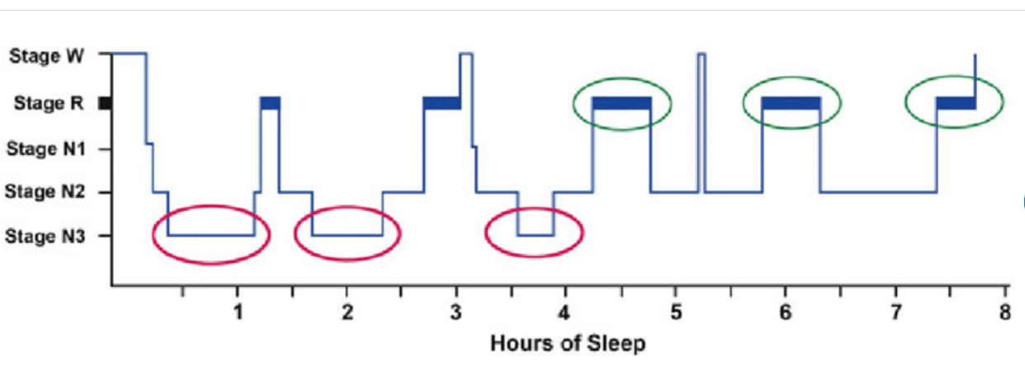
Sleep Biology
Wakefulness
Two Distinct types of sleep
  Non-Rapid Eye Movement (NREM)
    Within NREM there are 3 stages (Stage 1, 2, 3)
      Stage 3 - SWS
  REM Sleep
In humans, NREM and REM sleep alternate or “cycle” through the night in a pattern every 90-120 min
NREM is more common in the first part of sleep, while REM is more common in the latter half of sleep.

Slide 4
Two Memory Stores
Active system consolidation during sleep.
  During slow-wave sleep (SWS) memories newly encoded into a temporary store (i.e. the hippocampus in the declarative memory system) are reactivated to be redistributed to the long-term store (i.e. the neocortex).
    Declarative memory can be considered as the consciously accessible memories of fact-based information (i.e., knowing “what”, ex knowing the alphabet).
    Take come for students – NO ALLNIGHTERS!
  Non-declarative memory can be regarded as nonconscious. REM sleep.
    Procedural (i.e., knowing “how”, ex shooting a basketball) - learning of actions, habits, and skills
  But recent research shows this isn’t as clear cut. What is known - In order for optimal consolidation of both procedural and declarative memories to occur, SWS and REM sleep must take place in succession.

Slide 5
Academic Performance
Sleep deficit has been associated with lack of concentration and attention during class.
  Sleep deficit and sleep quality is assoc with smartphone use prior to bed
2019 Study of MIT undergraduates over a semester in an Intro Chemistry Class
  Did not find that sleep duration the night before an exam was associated with better test performance.
  Instead, both longer sleep duration and better sleep quality over the full month before a midterm were more associated with better test performance.
  Rather than the night before a quiz or exam, it may be more important to sleep well for the duration of the time when the topics tested were taught.
Similarly, sleep inconsistency plays a part in academic performance. Sleep inconsistency (sometimes called “social jet lag”) - typically seen in the form of sleep debt during weekdays followed by oversleep on weekends.
  Sleep inconsistency tends to be greatest in adolescents and young adults who stay up late but are constrained by strict morning schedules. Adolescents who experience greater sleep inconsistency perform worse in school

Slide 6
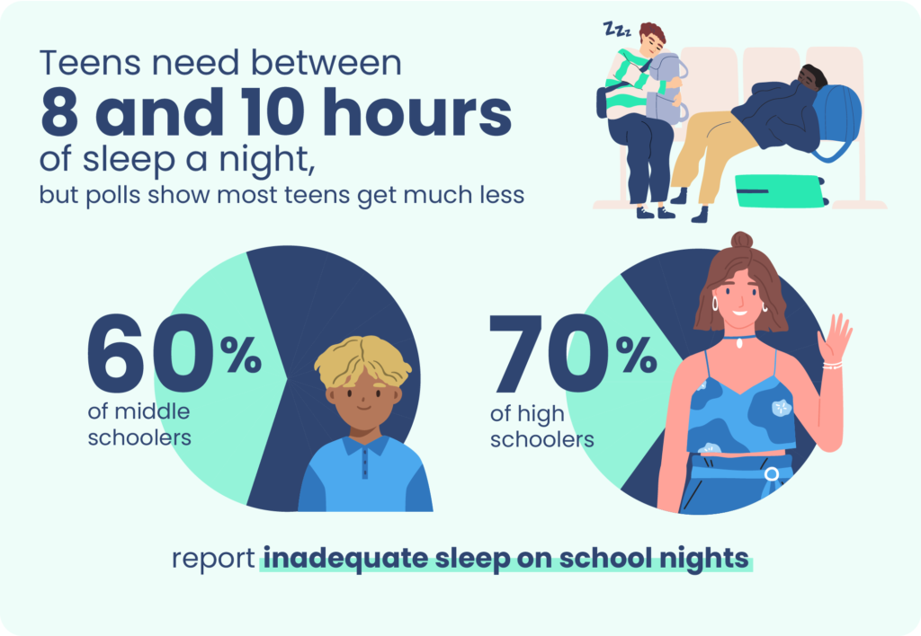
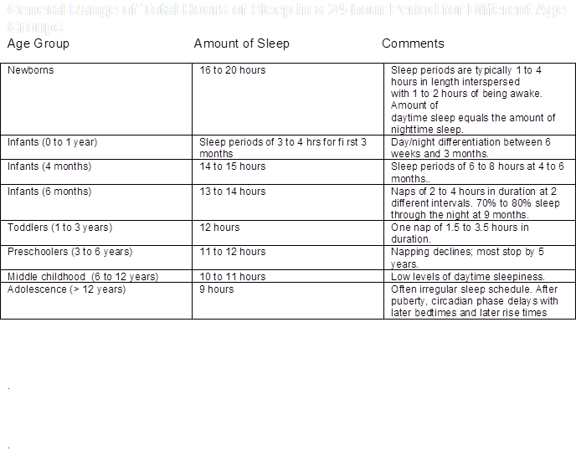

Slide 7
Athletic Performance
Most studies have looked at effect of sleep restriction -> negative impact on cardiorespiratory function, accuracy and consistent performance in many athletic activities
Stanford Study 2011 - Eleven healthy students on the Stanford University men's varsity basketball team
Design: Habitual sleep-wake schedule for a 2–4 week baseline followed by a 5–7 week sleep extension period. Subjects obtained as much nocturnal sleep as possible during sleep extension with a minimum goal of 10 h in bed each night.
Results: Total objective nightly sleep time increased during sleep extension compared to baseline by 110.9 ± 79.7 min (regular nighttime schedule & daytime naps)
Athletic measurements taken AFTER practice
  Faster sprint time
  Increased FT percentage by 9%
  Increased 3 pt percentage by 9.2%

Slide 8
Sleep as Injury Prevention
2024 Study of College Soccer and Basketball Student Athletes
  Athletes with poor sleep quality during preseason baseline testing had a significantly higher odds (2.2 times) for knee and ankle injury risks compared with student-athletes without poor sleep quality.
  Optimal sleep is a crucial element in the recovery process for competitive athletes. Avoiding a combination of relative energy deficiency in sport, excessive training and competition load and inadequate recovery is crucial to mitigating injury risk, protecting athletes' overall health and optimizing performance.

Slide 9
Circadian Rhythm and Athletic Performance
Retrospective NFL study 2013 - Reviewed the past 40 years of evening and daytime professional football games between west coast and east coast United States teams.
Results were strongly in favor of the west coast teams during evening games against east coast teams, with the west coast teams beating the point spread about twice as often (t = 3.95, P < 0.0001) as east coast teams. For similar daytime game match-ups, we observed no such advantage.
Professional football players playing close to the circadian peak in performance demonstrate a significant athletic advantage over those who are playing at other times.

Slide 10
Take home
Sleep is important for our brains and our bodies.
Peak learning and peak athletics can best be achieved with maximizing sleep consistency and quality
Best Sleep Habits:
  Going to bed and getting up at the same time every day.
  Keeping your bedroom quiet, relaxing, and at a cool temperature.
  Turning off electronic devices at least 30 minutes before bedtime.
  Avoiding caffeine in the afternoon or evening.
  Exercising regularly and maintaining a healthy diet

Slide 11
Contact: Name / email@choc.org

Slide 12
Academic Performance
Sleep is a fundamental and evolutionarily conserved aspect of animal life.
Sleep supports the formation of memory.
  This is a long-standing idea dating back to Ebbinghaus and the beginnings of experimental memory research (Ebbinghaus 1885).
One essential role of sleep is in the consolidation and optimization of synaptic circuits to retain salient memory traces despite the noise of daily experience.

